Slide 1

INSTITUTE UIE
DEPARTMENT ACADEMIC UNIT-1
Bachelor of Engineering (Computer Science & Engineering)
Subject Name Introduction Electrical & Electronics Engineering
Subject Code 23ECH-101
Prepared By
Dr. Shikha
Unit-2 Chapter-1
Combinational and Sequential Circuits
Lecture No. 2.1.3
SUBTRACTOR
DISCOVER . LEARN . EMPOWER

Slide 2

Lecture Objectives
S. No. | Objectives
1 | To make student aware about the derivation of logic for half and full subtractor circuit.
2 | To aware about implementation of subtractor circuit.
3 | To learn about design of full subtractor using half subtractors.

Slide 3
Course Objectives
S. No. | Objectives
1 | Understand Electrical & Electronics Engineering Fundamentals
2 | To prepare students to perform the analysis and design of various Electrical & digital electronic circuits.

Slide 4
Course Outcomes
CO Number | Title | Level
CO1 | To identify the different types of electrical elements and the basic op-amp circuit elements and to illustrate the various types of motors, transducers. | Remember
CO2 | To understand basic principles of transformers, transducers, op-amps, DC and AC motors and to compare the different methods for analysing electrical and magnetic circuits. | Understand
CO3 | To derive the relationships between parameters in electric and magnetic circuits and motors and to determine specifications of op-amps. | Analyze
CO4 | To solve the basic problems related to electric circuits, magnetic circuits and motors and to assess the characteristics of different configurations of op-amps. | Evaluate
CO5 | To design the different applications of transducers, motors as well as the op-amps like adders, subtractor and comparators. | Create

Slide 5
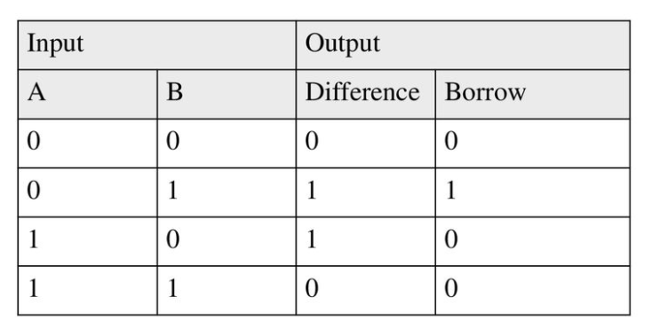
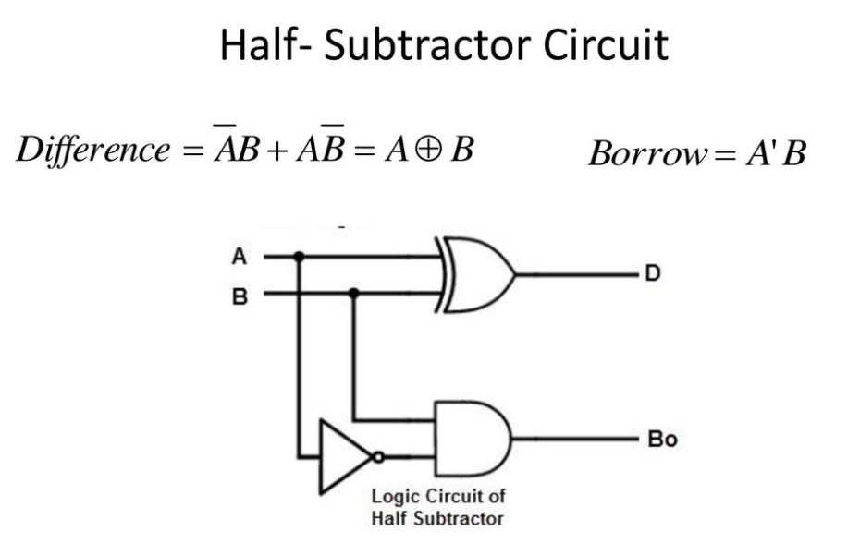
Half-Subtractor
For one bit half subtractor follow the given logic table.

Slide 6
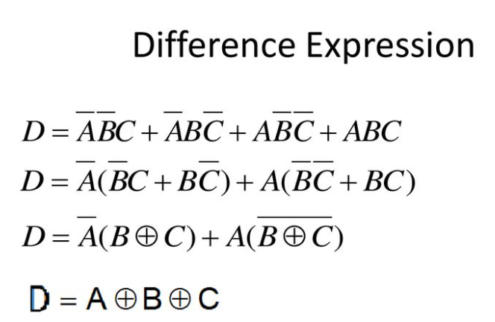
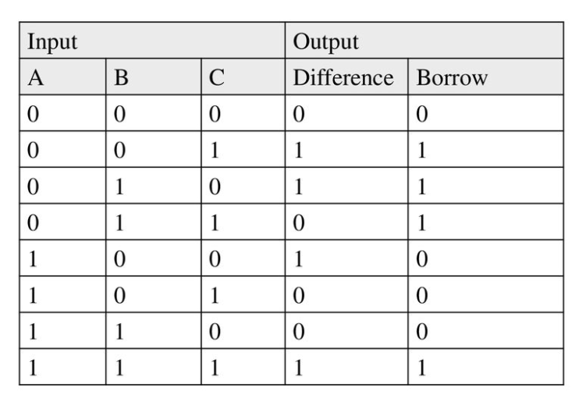
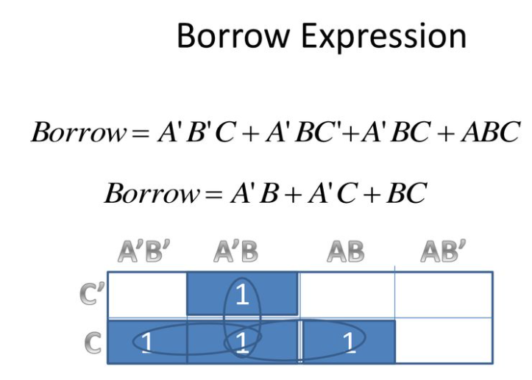
Full-Subtractor
For one bit Full subtractor follow the given logic table.

Slide 7
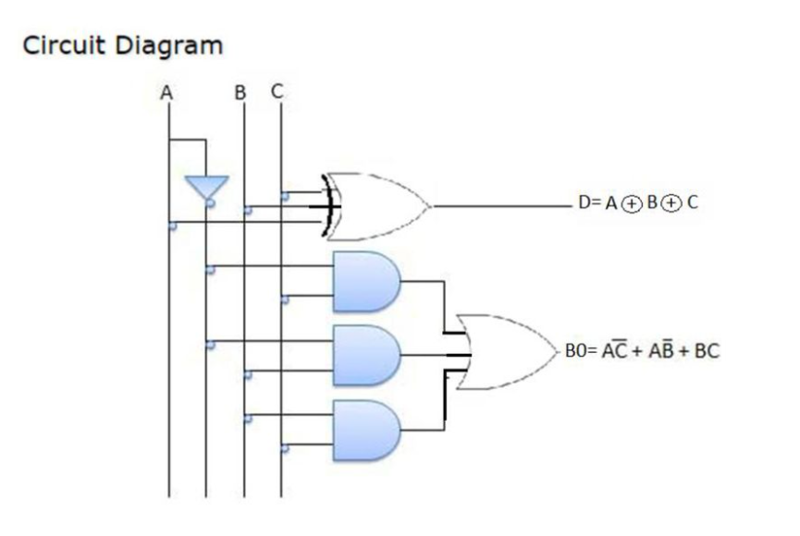
Full-Subtractor

Slide 8
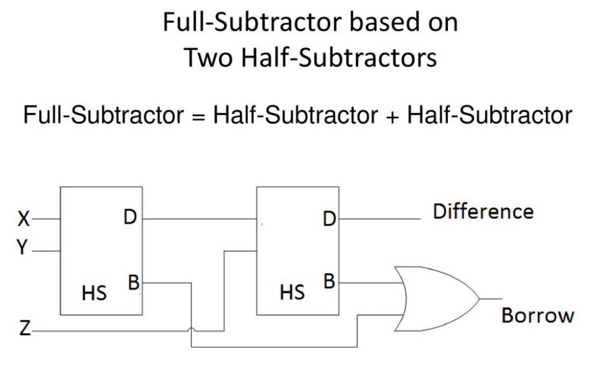

Slide 9
REFERENCES
https://www.google.com/search?q=number+system+in+digital+electronics&source=lnms&tbm=isch&sa=X&ved=0ahUKEwjOsbqmnvPiAhXPZCsKHXrSBJYQ_AUIESgC&biw=1366&bih=657#imgrc=DBR-RpBVZAmHDM:
https://www.google.com/search?q=decimal+to+binary&source=lnms&tbm=isch&sa=X&ved=0ahUKEwi6nMvW5uHiAhVBXSsKHUgGC60Q_AUIECgB&biw=1517&bih=730#imgrc=cl-xz1ixddfv9M
www.cse.yorku.ca/~mack/1011/01.NumberSystems.ppt
https://www.google.com/search?q=binary+to+grey+conversion&source=lnms&tbm=isch&sa=X&ved=0ahUKEwjD6vrQi-PiAhVMSX0KHftLDngQ_AUIECgB&biw=1366&bih=657#imgrc=bkt5qsZlpTZ1sM
http://www.geeksforgeeks.org/digital-electronics-logic-design-tutorials/
https://www.google.com/search?q=binary+to+grey+conversion&source=lnms&tbm=isch&sa=X&ved=0ahUKEwjD6vrQi-PiAhVMSX0KHftLDngQ_AUIECgB&biw=1366&bih=657#imgrc=bkt5qsZlpTZ1sM
http://www.ni.com/example/14493/en/
https://www.tutorialspoint.com/digital_electronics/index.asp
https://www.tutorialspoint.com/computer_logical_organization/complement_arithmetic.htm
Floyd & Jain, Digital Fundamentals, Pearson.
Mano, Morris, Digital Design, Prentice Hall of India.
Fletcher, An Enggineering Approach to digital design, Prentice Hall of India.

Slide 10
References
Video link for Digital Electronics
https://www.youtube.com/watch?v=2xXErGeeb_Q
https://www.youtube.com/watch?v=M0mx8S05v60&list=PLBlnK6fEyqRjMH3mWf6kwqiTbT798eAOm
E Book for Digital Electronics
https://www.electronicsforu.com/resources/15-free-electronics-ebooks
Other important link
NPTEL
https://nptel.ac.in/courses/108/105/108105132/
https://nptel.ac.in/courses/117/106/117106086/
https://executivefunctioningsuccess.com/wp-content/uploads/2010/06/analog-vs-digital.png [1]
http://www.technologyuk.net/telecommunications/telecom-principles/images/digital_signal02.gif[2]

Slide 11
THANK YOU

